Slide 1
Smart Vehicles Hardware and Processors
Advisor: Hassan Rajaei
Presented by: Aakanksha Mahajan, Anusha Allu and Sampath

Slide 2
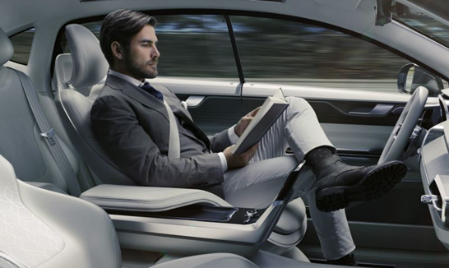
Introduction
What is a Smart Vehicle?
A Smart Vehicle is defined as a collection of various smart IoT devices which are connected to a network and effectively communicate with each other for providing a good travel experience for the user(s).

Slide 3
RQ1: How does communication take place using V2V and V2I?
RQ2: How does distributed and parallel communication takes place in smart vehicles?
RQ3: How reliably can communication help enhance efficiency and accuracy in smart connected cars and avoid failure?
Research Questions

Slide 4
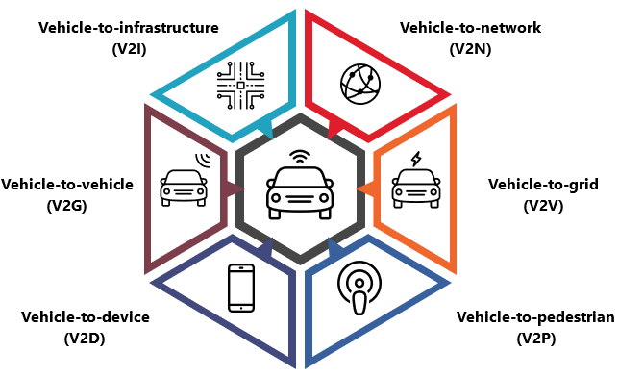
Notes:
Here we can oberserve in this picture that therea are many possibilities that a smart car can communicate with various other smart entites which are connected to a network.
This communication can be extabloished using one of most emergig technology which is known as VANETs.
Under the classification of VANETs we have various types of communications: V2V, V2I, V2P etc
In this presentation we maily foucs on how communication takes place in V2V and V2I techniques.

Slide 5
Vehicle-to-Vehicle Communication:
Vehicle-to-Vehicle (V2V) Communication is a most recent and advanced approach where smart cars talk or share information with each other electronically in real time. This sharing of information helps the smart vehicle to provide safety and a good travel experience.
Vehicle-to-Infrastructure Communication:
Vehicle-to-Infrastructure (V2I) Communication is also an advanced technology in VANETs which aims at establishing communication between the smart car and the Road Side Units (RSU).
What is V2V and V2I Communication?

Slide 6
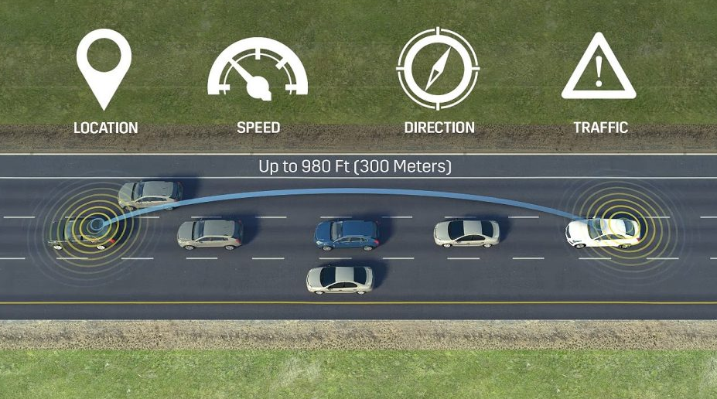
How V2V and V2I Communication Work?
Vehicle-to-Vehicle and Vehicle-to-Infrastructure Communication basically works on the principle of Distance Short-Range Communication (DSRC).
Dedicated Short-Range Communication is a new way of establishing communication which uses 75MHz frequency of spectrum which is allowed by the standards of Federal Communication Commission (FCC).
This communication helps to increase the safety of the traveler, fuel consumption is reduced and pollution as well.

Slide 7
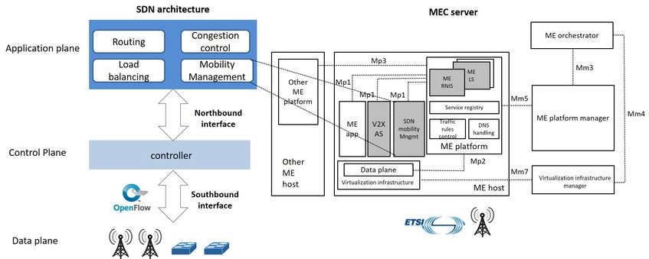
SDN-MEC Architecture Support
Notes:
Explain Here for establishing the communcation between the vehicles or the RSU, we follow an architecture which is designed by integrating the newly emerging technology 5G and the Mobile Edge Computing (MEC).

Slide 8
Smart Vehicles 'x' and 'y' use cellular network to communicate.
SDN Controller of the SDN-MEC server finds a path for communication?
Notify both the smart vehicles to switch from cellular to V2V VANET offloading using V2V path.
Smart Vehicles 'X' and 'y' communicate using theV2V path.
Maintain a Life-Time Session for future purpose.
Flow of Establishing Communication

Slide 9
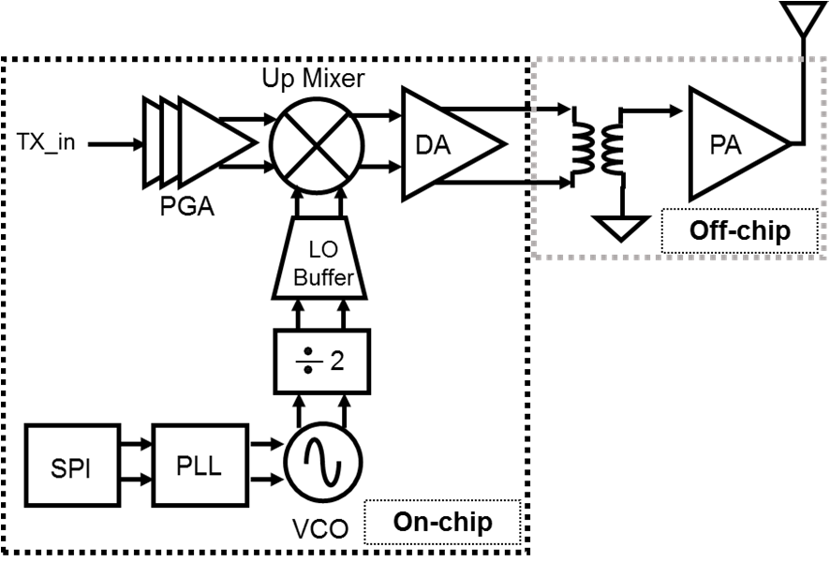
5.9Ghz DSRC Transmitter.
This hardware works on IEEE 802.11p.
Components included:
Programable Gain Amplifier.
Drive Amplifier.
Serial Peripheral Interface.
Hardware Support for DSRC

Slide 10
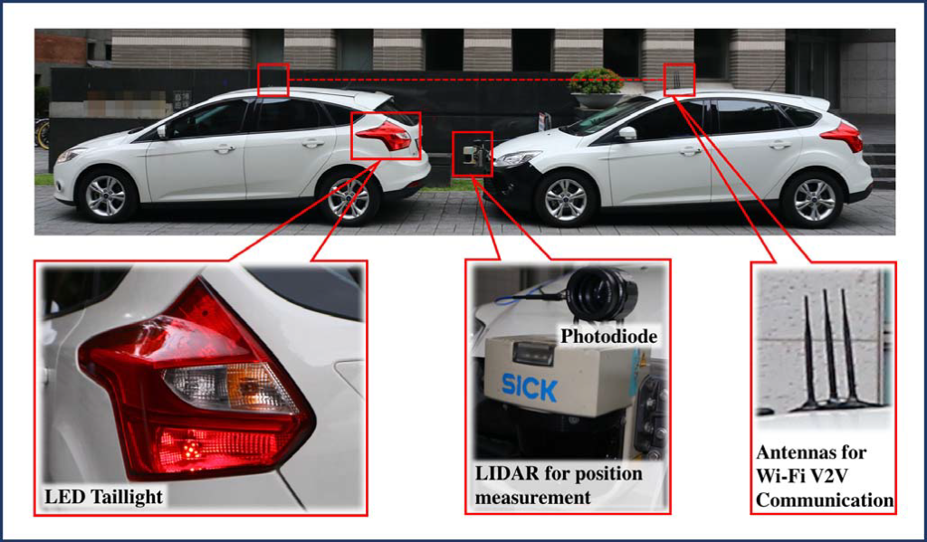
CASE STUDY
Vehicle-to-Vehicle Communication using Visible Light Communication (VLC).
Includes two key components for sharing information between the Smart Vehicles or Road Side Units (RSU).

Slide 11
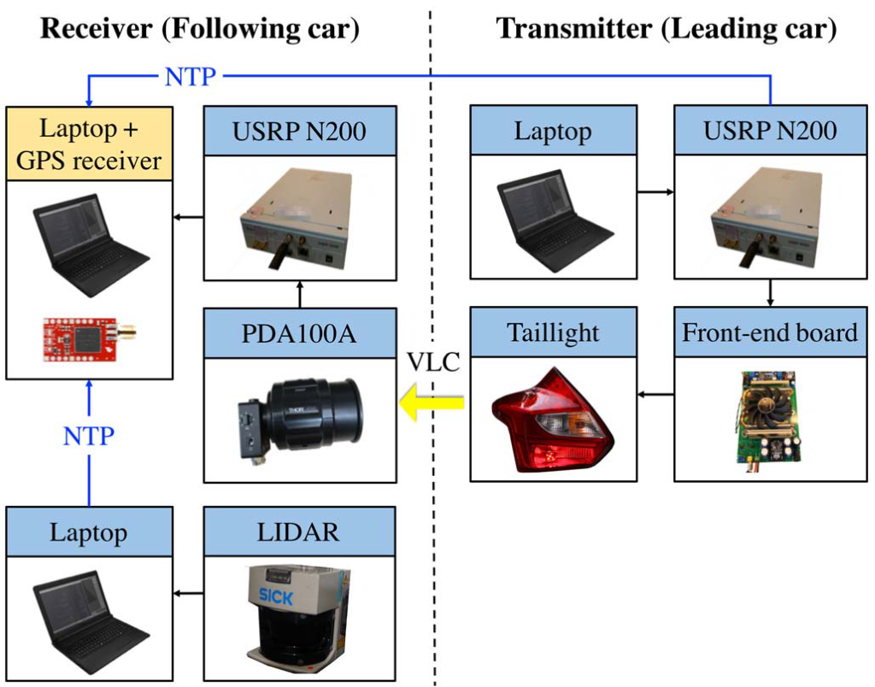
CASE STUDY
Transmitter (Leading Vehicle):
Laptop
Universal Software Radio Peripheral (USRP).
Front-end Board.
Tail Light.
Receiver (Following Vehicle):
GPS Receiver.
Universal Software Radio Peripheral (USRP).
LIDAR.
Antennas.

Slide 12
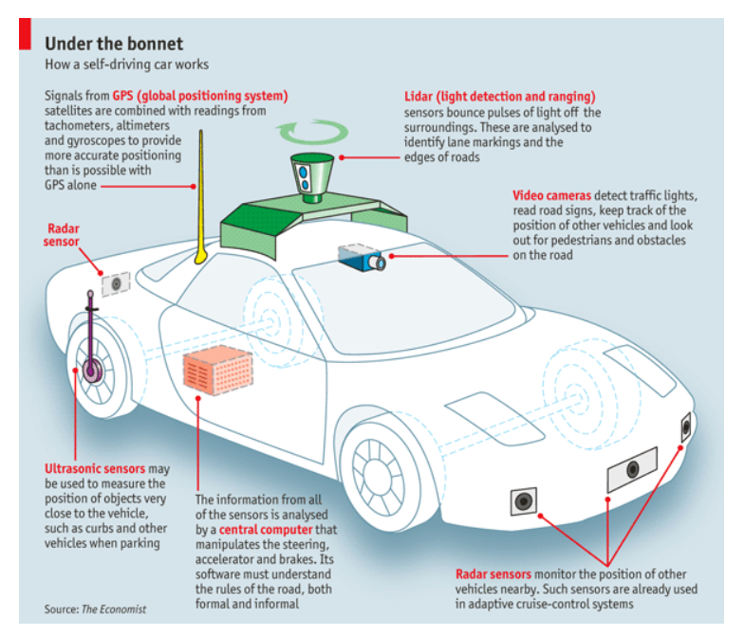
Sensor Information
As per today on an average there are 60-100 sensors in a car.
It is estimated that a car will have 200 sensors on an average.
GPS
LiDAR
Radar
Ultrasonic
Video Cameras
Central Computing System

Slide 13
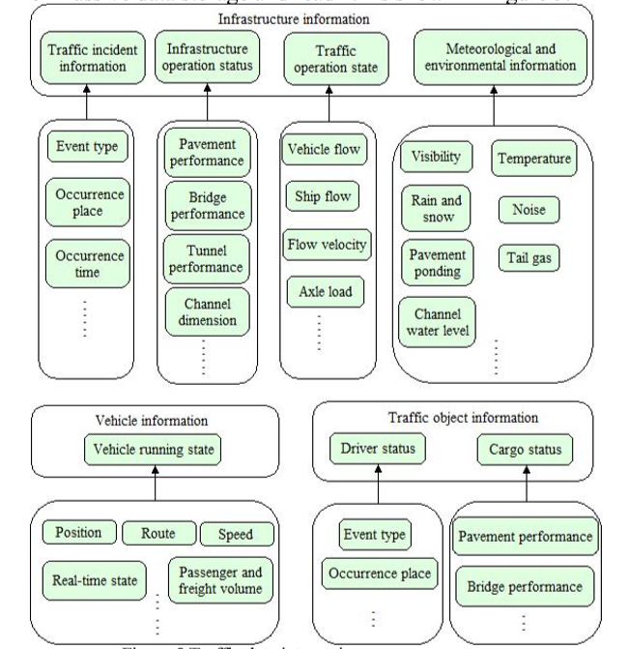
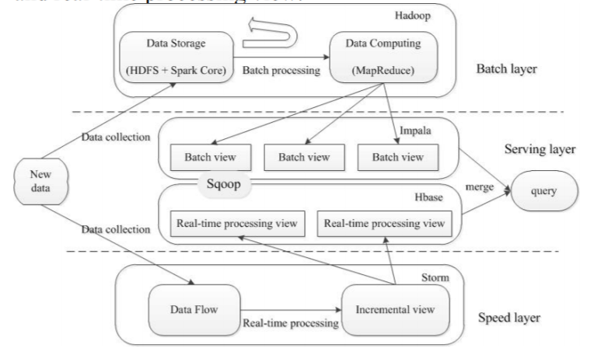
Real Time Data Processing

Slide 14
Reliability of communication between the vehicles and the infrastructure
Data Age MAC scheme which ensures reliable communication between the vehicles using the concept of platoon of vehicles. This scheme is like an alternate to the standard IEEE 802.11p standard.
Reliability and Performance Statistics with example how V2V communication is proving to be reliable using the use case of predicting crash or collisions of vehicles.

Slide 15
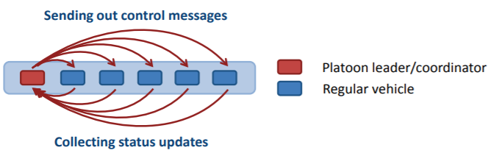
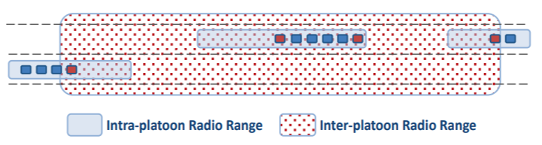
Reliability of communication between the vehicles and the infrastructure
Data Age MAC scheme

Slide 16
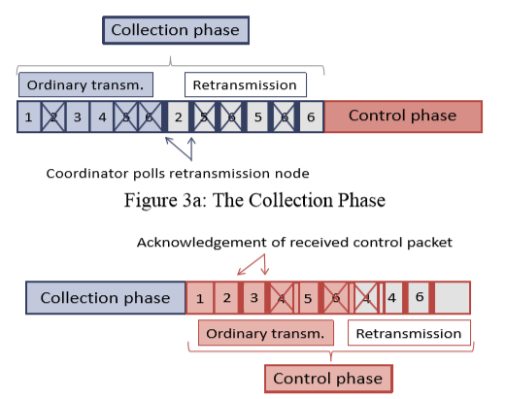
Reliability of communication between the vehicles and the infrastructure
Data Age MAC scheme

Slide 17
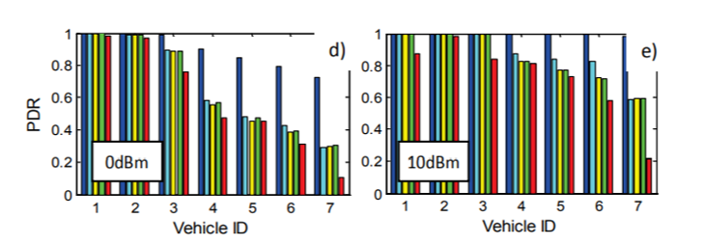
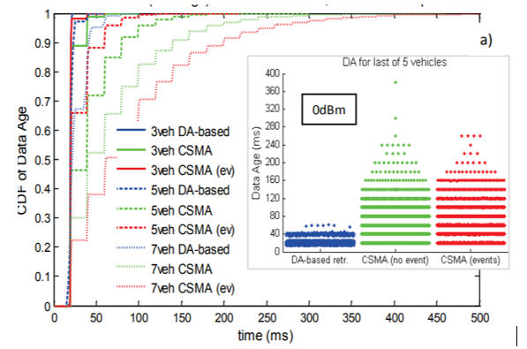
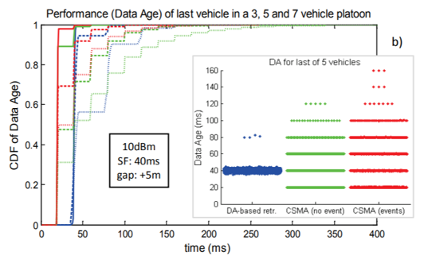
Reliability of communication between the vehicles and the infrastructure
Data Age MAC scheme

Slide 18
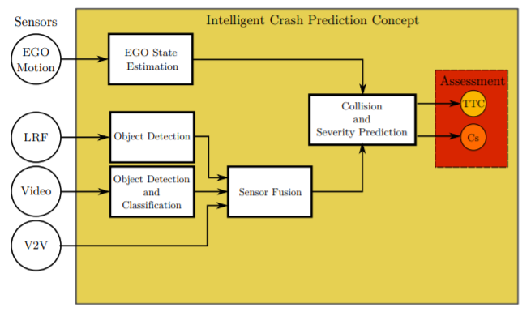
Reliability of communication between the vehicles and the infrastructure
Reliability and Performance Statistics of V2V communication

Slide 19
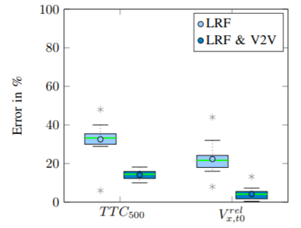
Reliability of communication between the vehicles and the infrastructure
Reliability and Performance Statistics of V2V communication
TTC error without V2V (33.6%) is higher than using V2V data (21.66%)
Mean Vx error using V2V data is smaller (5%) when compared to the mean error (14%) using sensors.

Slide 20
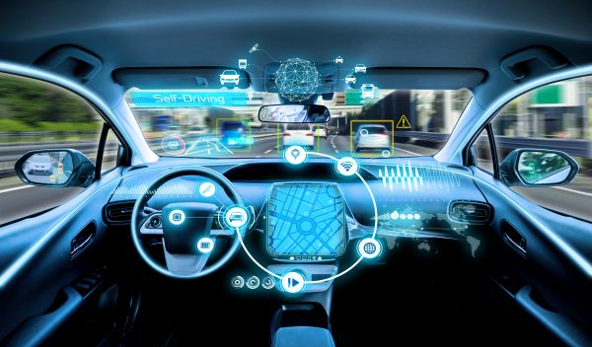
Parallel and Distributed Communication in Vehicles

Slide 21
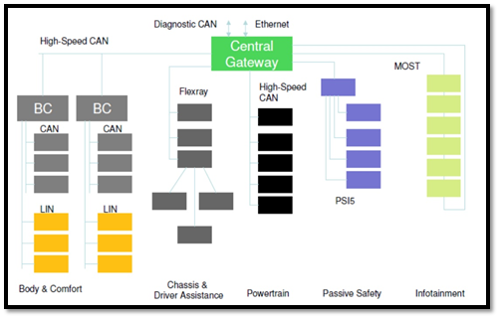
In-Vehicle Communication Architecture
Few network protocols used in Vehicle communication are:
LIN (Local Inter-Connect Network)
CAN (Controller Area Network)
FlexRay
MOST (Media Oriented Systems Transport)

Slide 22
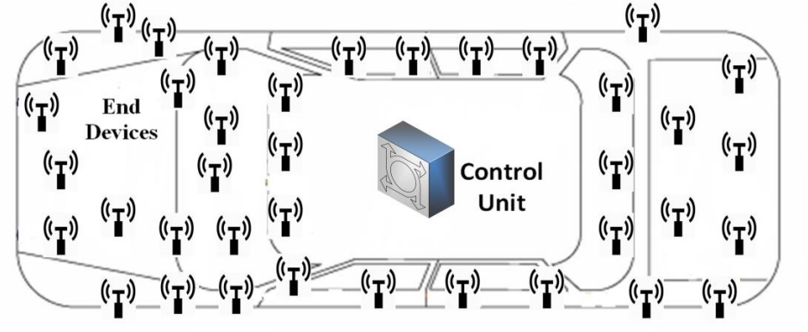
Intra- Vehicular Wireless Sensor Networks
CAN bus is not flexible to handle a greater number of sensors
Wireless architectures help in such scenarios
Various sensors in the vehicle share the data that sensors generate to develop a smart car
ZigBee, RFID, WiFi, and Bluetooth can be used to make use of IoT

Slide 23
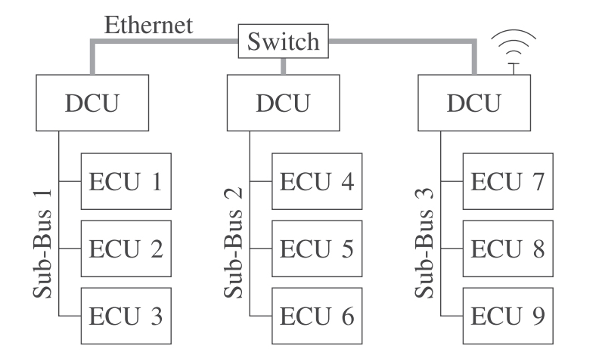
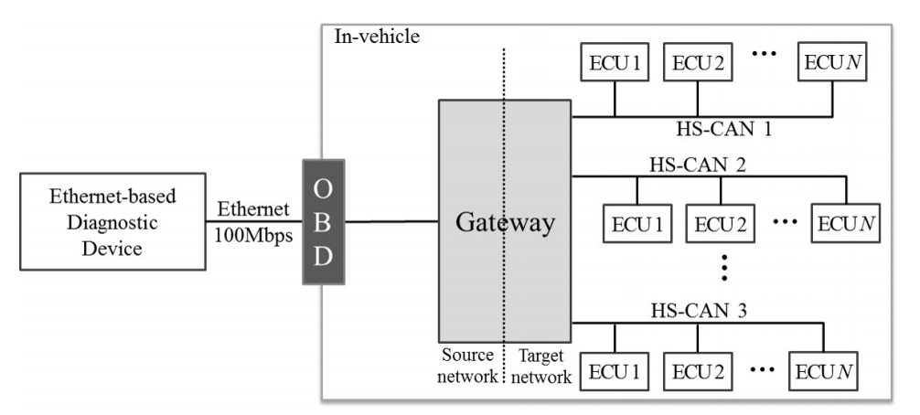
Parallel Communication in Intra-Vehicles
Future Intra Vehicular Network Architecture

Slide 24
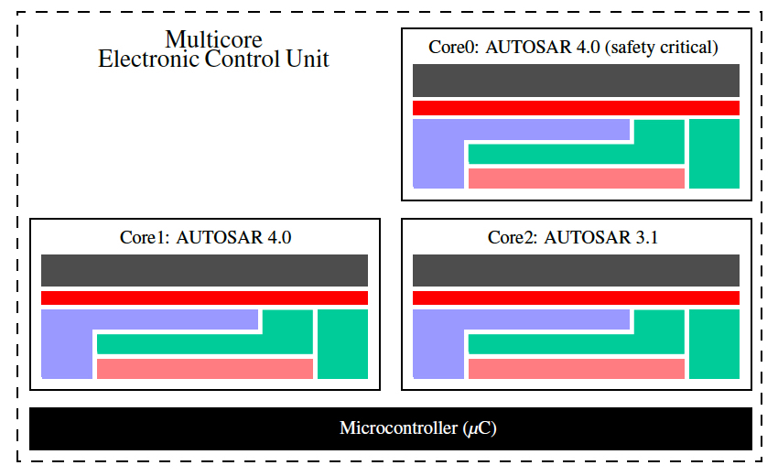
Multicore systems can be used
Software components must be integrated with less ECUs
Use of Large-Scale Software Integration techniques
Parallel Communication in Intra-Vehicles
Possible partitioning for Multicore components

Slide 25
Processors for Automobiles
Parallel Communication in Intra-Vehicles
Intel Atom Automotive Processors
Intel Field Programmable Gate Arrays (FPGAs)
GPUs
Arm Multi Core Processors

Slide 26
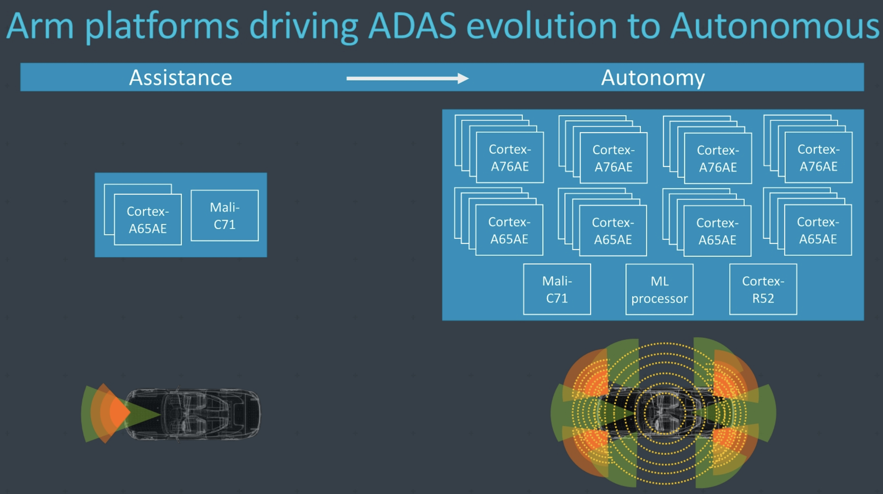
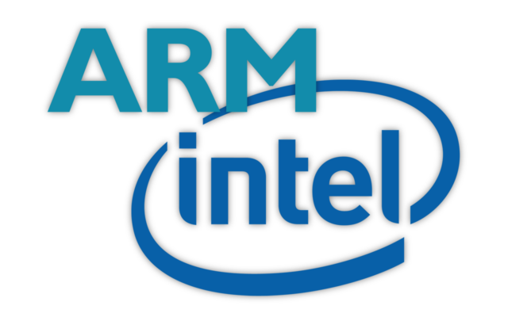
Example
Arm releases Cortex A76AE processor for automobiles in December,2018
Dual core allows to gain high performance
Different clusters of CPU cores are responsible for different work load tasks

Slide 27
Distributed Communication in IoV
5G
Mobile Edge Computing (MEC)
SDN – Software Defined Networking
NFV – Network Function Virtualization
Network Slicing

Slide 28
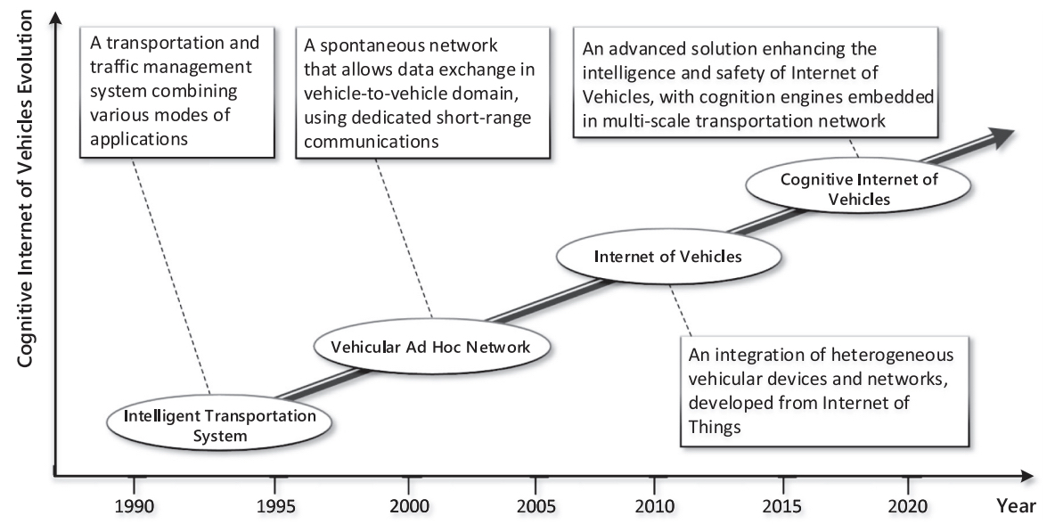
Evolution of CIoV
Internet of Vehicles

Slide 29
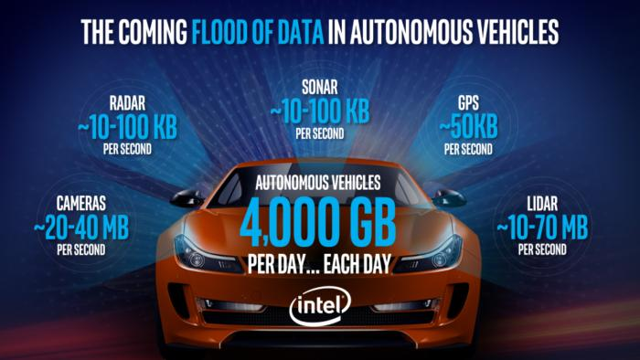

Slide 30
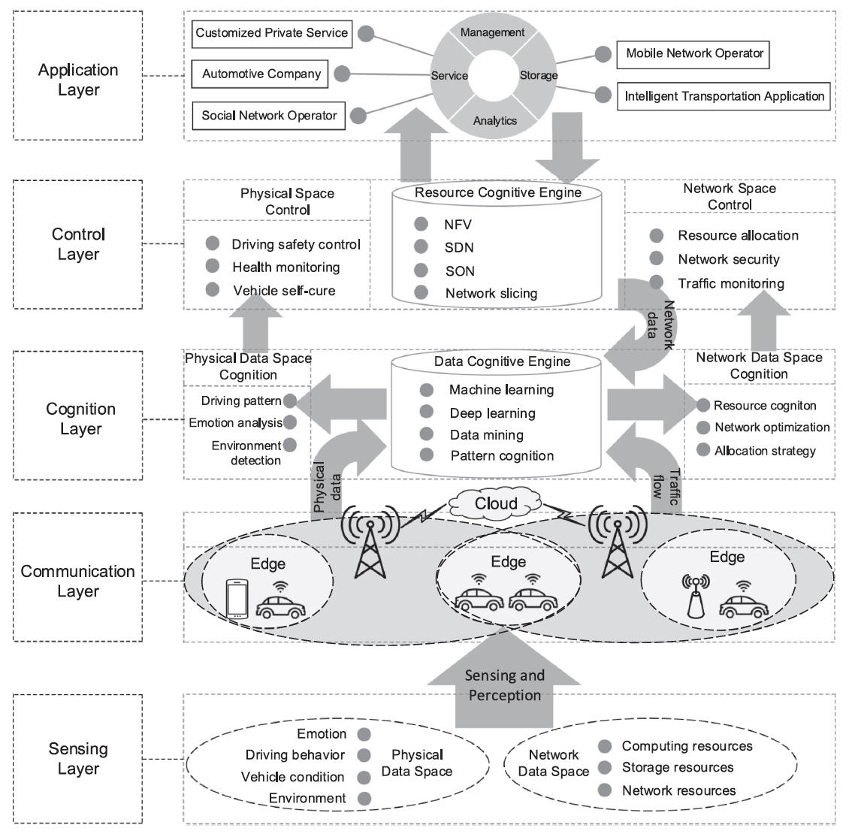
Architecture of CIoV
Cognitive Internet of Vehicles

Slide 31
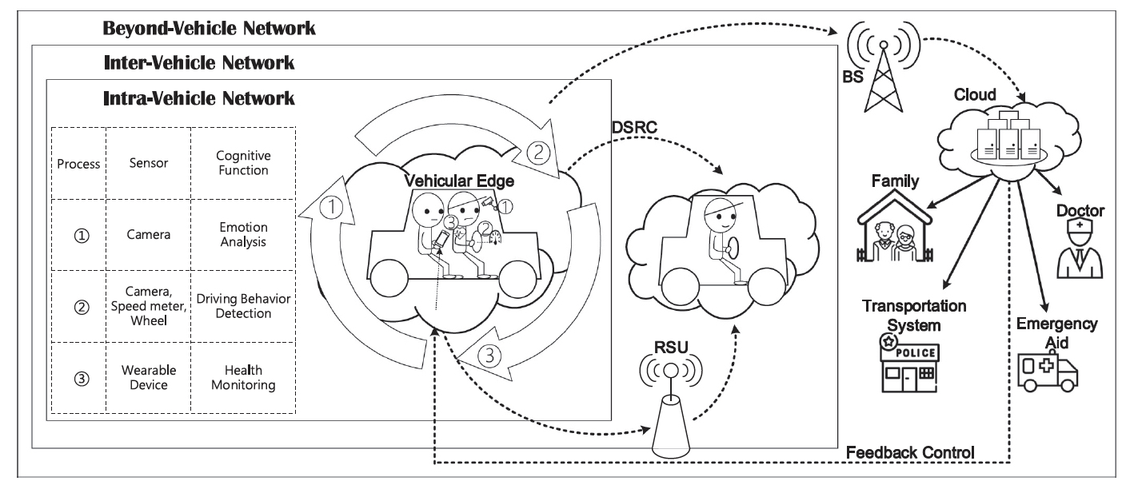
Example of CIoV
Healthcare in Autonomous Vehicles

Slide 32
Conclusion
V2V Communication is reliable.
V2V and V2I Communication can be implemented with the support of SDN-MEC Architecture.
The newly emerging 5G technology helps in enhancing fast communication which helps the smart vehicles to make quick decisions and provide user(s) a good travel experience by maintaining safety.
Latest processors like ARM multi core processor can be used to achieve parallel programming inside vehicles
Using Edge Computing, distributed communication can be achieved

